Slide 1
Connecting to a Network
Lesson 5

Slide 2
Objectives
Understand the OSI Reference Model and its relationship to Windows 7 networking
Install and configure networking components
Use the Network and Sharing Center
Configure TCP/IP manually and automatically
Use TCP/IP tools to troubleshoot network connectivity problems
Notes:
Outline the material you are going to cover in this lesson. Do not go into detail as each of these points will be expanded on in the lesson. You may also want to mention the Technology Skills that are being covered for the Certification exam also.

Slide 3
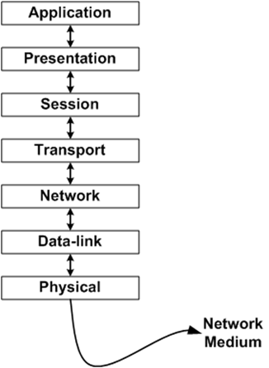
OSI Reference Model
Notes:
Depending on your students’ background and the purpose of your course, you may want to spend time on the OSI Reference Model to help define networking before talking about networking with Windows 7. There is extensive information in the textbook to allow you to go into a lot or a little detail of the OSI Reference Model.

Slide 4
Physical Layer
The physical layer is concerned with the interface to the transmission medium.
Data is transmitted onto the medium (e.g. coaxial cable or optical fiber) as a stream of bits
Two parts of the physical layer
  cable or the radio signals
  network interface adapters

Slide 5
Data-link Layer (cont.)
Use the Ethernet protocol.
Sometimes described as pacbet-suitching networks
Ethernet is the protocol responsible for addressing the packets at the datalink layer
Surrounding the data it receives from the network with a header and footer
Header and footer and the data they contain are collectively called a frame, and the process of applying it is called data encapsulation

Slide 6
Network Layer
IP is
  the network layer protocol
  the primary end-to-end protocol used on most data networks
IP routing
  The Internet is a huge conglomeration of networks, all connected together by devices called routers
  A router is simply a device that connects one network to another.

Slide 7
Network Layer (cont.)
IPv4
  uses to identify all of the devices on a network
  independent of the hardware addresses assigned to network interface adapters
  defines a 32-bit address space
Each address is split into two parts
  Network identifier - specifies the network on which a particular system is located
  Host identifier:- specifies a particular network interface (also called a host) on the networK.

Slide 8
Network Layer (cont.)
Assigning IP addresses
  Manual configuratio
  Dynamic Host configuration Protocol (DHCP) - a client/server application and protocol that enables clients to obt"in IP addresses from a pool provided by a-server.
  Automatic Private Ip Addressing (APIPA) – When a vindows 7 computer with no IP address srarrs, and it fairs to locate aDHCP server on the network, the TCP/IP client automatically configures itself using an address in the 169.254.0.0/16 network.

Slide 9
Network Layer (cont.)
IPv6
  use hexadecimal notation, in the form of eight rwo-byte values, separated by colons
  XX: XX: XX: XX: XX: XX:XX:XX
  FDCǾ : Ǿ2Ǿ2 : ǾǾǾǾ : Ǿ2BD : ǾǾF F : BECB : FEF4 : 961D

Slide 10
Transport Layer
Two types of protocols that operate at the transport layers
  TCP a connection-oriented Protocol
  UDP a connectionless protocol
transport layer protocols are concerned with idenifiing the applications that created the packet and to which the packet will ultimately be delivered

Slide 11
Transport Layer (cont.)
The header in the Transport layer use ports to identify specific applications running on the system
the combination of an IP address and a port number is called a socket
the standard port number for the Hypertext Transfer Protocol (HTTP), the application layer protocol used for web communications, is 80

Slide 12
Session Layer
Control "sessions", which are logical connections between network devices
A session consists of a dialog, or data communications conversation, and can be
  simplex (one-way)
  half-duplex (alternate)
  full-duplex (bi-directional)

Slide 13
Presentation Layer
Ensures that information sent by the application layer of one system will be readable by the application layer of another system
Provides a common format for transmitting data across various systems, so that data can be understood, regardless of the types of machines involved

Slide 14
Application Layer
Provides services to application programs outside the scope of the OSI model
Services are often part of the application process services include;
  synchronizes the sending and receiving applications
  establishes agreement on procedures for error recovery and control of data integrity
  determines whether sufficient resources for the intended communications exist

Slide 15
Installing Network Support
Default networking components installed:
  Client for Microsoft Networks
  QOS Packet Scheduler
  File and Printer Sharing for Microsoft Networks
  Internet Protocol Version 6 (TCP/IPv6)
  Internet Protocol Version 4 (TCP/IPv4)
  Link Layer Topology Discovery I/O Driver and Link Layer Topology Discovery Responder
Notes:
Describe how Windows 7 will automatically install the above components when a network interface adapter is detected on the computer during installation. Describe the purpose of each component.

Slide 16
Network Locations
Home
Work
Public
Domain
Notes:
Network locations are combinations of network discovery and file sharing settings which determine how much access the workstation user will have to the network and how much access network users will have to the workstation. Describe each of the settings and when you would use each one.

Slide 17
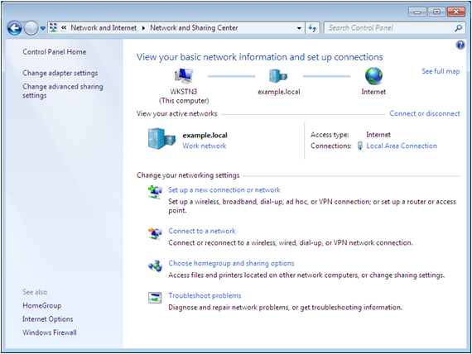
Using the Network and Sharing Center
Summary
Network Map
Task List
View Your
Active Networks
Change Your
Networking Settings
Notes:
Describe the elements of the Network and Sharing Center

Slide 18
Understanding Network Discovery
Controls Windows Firewall settings
A firewall is a barrier between the computer and the network that allows certain types of traffic through, and blocks other traffic.
Firewalls filter using TCP/IP characteristics:
  IP addresses
  Protocol numbers
  Port numbers
Notes:
Explain that this feature was introduced in Windows Vista. It is a simple way for non-technical users to change firewall settings by selecting simple configuration options. You need to understand how a firewall works in order to understand what Network Discovery is doing for you. Describe the purpose of a Firewall and that its configuration can be extremely complex.

Slide 19
Understanding Network Discovery (cont.)
If, for example, you want to prevent all computers on the nerwork from accessing your system using the Telnet protocol, you would configure the firewall to block the traffic from all IP addresses using TCP port number 23, the well-known port number associated with Telnet.
Notes:
Explain that this feature was introduced in Windows Vista. It is a simple way for non-technical users to change firewall settings by selecting simple configuration options. You need to understand how a firewall works in order to understand what Network Discovery is doing for you. Describe the purpose of a Firewall and that its configuration can be extremely complex.

Slide 20
Network Discovery Settings
ON or OFF – Controls two functions:
Whether the computer can see and be seen by the other systems on the network
Whether the computer can share its resources and access shared resources on the network
Notes:
Expand on what happens when Network Discovery is turned ON or OFF on a Windows 7 computer.

Slide 21
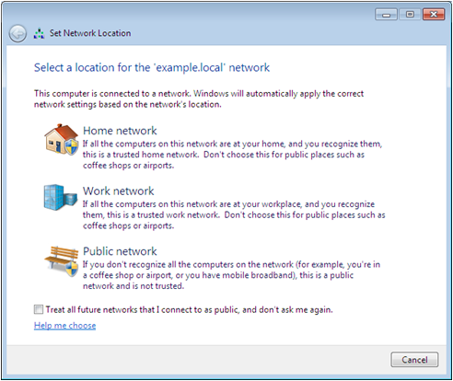
Changing the Network Location
Notes:
Although Windows 7 automatically can detect network location changes, you can also modify your network location by selecting it on the screen above.

Slide 22
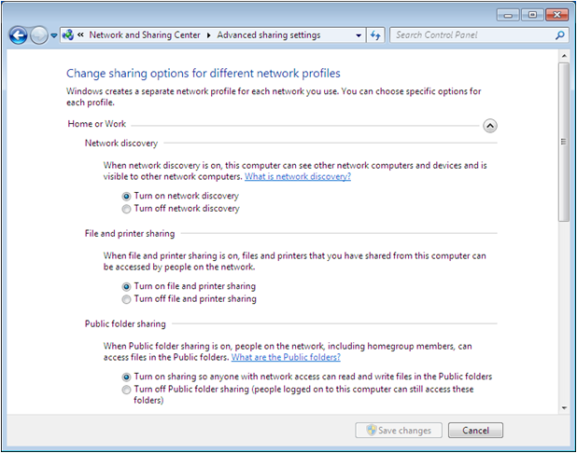
Configuring Advanced Sharing
Notes:
Describe the different sharing options that can be controlled for each network location setting.

Slide 23
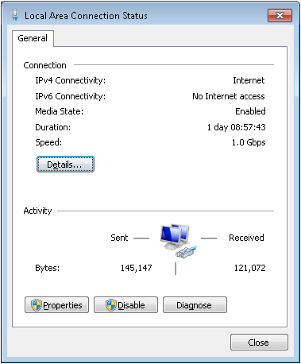
Viewing a Connection’s Status
Notes:
Each local area connection on a Windows 7 system has a status dialog box that displays real time information about the connection. Using the screen shot, describe the different pieces of information displayed and what it means, or demonstrate.

Slide 24
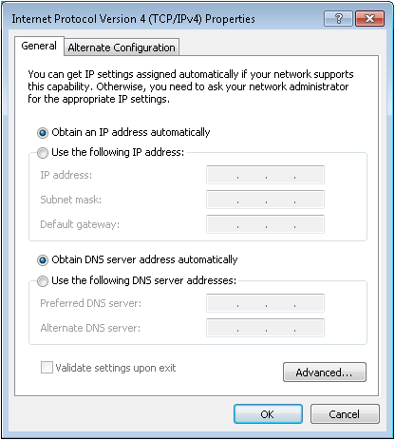
Configuring IPv4 Settings
Notes:
Explain or demonstrate how to get to this dialog box. Show the different settings for Automatic and Manual configuration, which will be explained on the next couple of slides.

Slide 25
Automatic TCP/IP Configuration
Uses DHCP – Dynamic Host Configuration Protocol
Clients request and receive addressing information from DHCP – Can be server or router
Notes:
Explain how a client gets an address from the DHCP server. Discuss how different devices can be the DHCP server.

Slide 26
Manual TCP/IP Configuration
Manually enter information into all fields in the TCP/IP Properties dialog box
Depending on whether you are connected to other networks, you do not have to fill out all fields
Minimum requirements:
  IP Address
  Subnet Mask
Notes:
Discuss under which situations you might need to manually configure your TCP/IP information and discuss the drawbacks of manual configuration. The specific fields of the dialog box are discussed on the next slides.

Slide 27
IPv4 Addressing
IP Address — Four sets of numbers between 0 and 255 separated by a dot. Each address is unique worldwide.
Subnet Mask — Used for network and host identification.
Network identifier Host identifier
Example: IP Address 142.204.34.136
Subnet Mask 255.255. 0. 0
Notes:
Briefly explain IP addressing and what an IP address is used for and what the Subnet Mask is used for. Explain why the IP addresses and Subnet masks only contain numbers between 0-255 and what the Network portion of the address is and the host identifier portion. There is a substantial amount of TCP/IP information at the beginning of the chapter. You can explain as much or as little as needed depending on students’ background and course requirements.

Slide 28
IPv4 Addressing cont’d
Default Gateway Address — router
DNS IP Address
  Domain Name Service is used to translate names like www.yahoo.com into an
  IP Address (64.58.76.222).
Notes:
Define the purpose of the Default Gateway and why it is only needed if your network is connected to the Internet or other networks. Define DNS and what it does. There is a substantial amount of TCP/IP information at the beginning of the chapter. You can explain as much or as little as needed depending on students’ background and course requirements.

Slide 29
Using Netsh.exe
Syntax:
netsh interface ipv4 set address connection_name static ip_address subnet_mask default_gateway
An example of an actual command would be as follows:
netsh interface ipv4 set address “Local Area Connection” static 192.168.1.23 255.255.255.0 192.168.1.1
Notes:
Explain what Netsh is used for and what the example accomplishes.

Slide 30
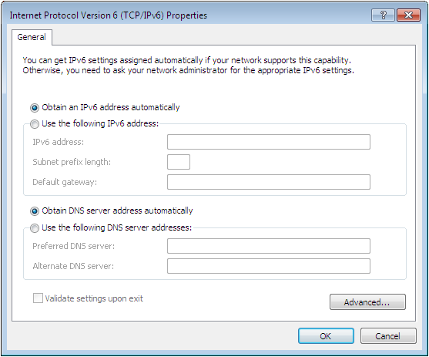
Configuring IPv6 Settings
Notes:
Explain that most computers use IPv6 autoconfiguration or DHCP, so manual configuration is rarely necessary, although possible. Essentially the procedure is the same as IPv4.

Slide 31
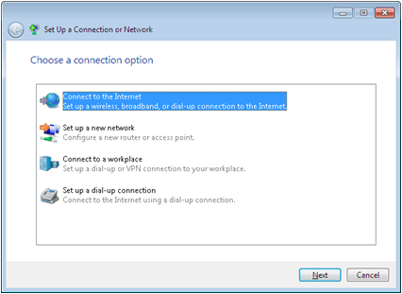
Create a New Network Connection
Local network connections are created automatically
Manual connections frequently have to be made
  Dial up connections
Notes:
Windows 7 creates local area network connections automatically, but desktop technicians frequently have to create other types of connections manually, such as dial-up Internet connections.

Slide 32
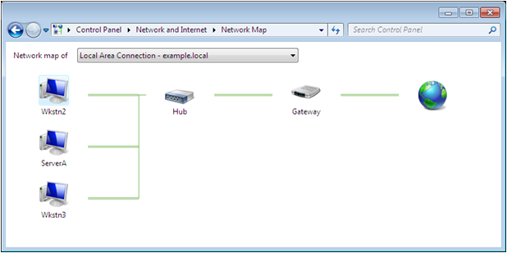
Network Map
Displays a graphical map of the computers on the network and the connection between them
Notes:
Network Map is an administration and diagnostics tool that displays a graphical map of the computers on the network and the connections between them
Network Map is a tool that first appeared in Windows Vista, and is now included in all of the Windows operating systems. Network Map automatically compiles a graphical representation of the network, including icons representing the computers, printers, and other devices attached to it, and lines representing the connections between these elements.
Network Map uses a protocol called Link Layer Topology Discovery (LLTD) to discover information about the network and the devices attached to it. LLTD devices called enumerators transmit requests for information over the network, and other computers, called responders, reply with the requested information. This protocol not only enables the computer to discover the existence of other systems on the network, it also tests the connections between them.

Slide 33
Displaying a Network Map
Network Discovery must be turned on.
If the computer is a member of a Windows domain, group policy must be configured to permit network mapping.
Any Windows XP computers on the network must have the LLTD Responder software installed.
Notes:
The Network and Sharing Center displays a summary map on its main window, but to display a complete map of the network, you must click the See full map link.
From a security standpoint, it is not a good idea to allow just anyone to access a map of your network. As a result, when a Windows 7 computer is a member of a Windows domain, network mapping is disabled by the default group policy settings. To control network mapping with group policy, you must use the Group Policy Management Console

Slide 34
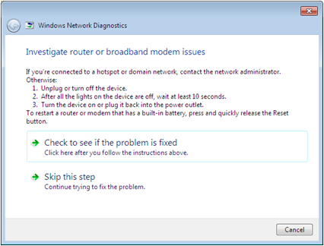
Running Network Diagnostics
Click on warning icon on network map and Windows Network Diagnostics launches
Attempts to discover the cause of the problem and offers possible solutions
Notes:
The Network Map displays shows not only the existence of the devices on the network, but their status, and that of the connections between them. Improperly configured computers have yellow warning signs on their icons and non-functioning connections have red X’s on them.
When a problem exists, clicking a warning icon launches Windows Network diagnostics. This utility attempts to automatically discover the cause of the problem and displays possible solutions.

Slide 35
Windows Network Diagnostics
Problems that can be diagnosed:
  Broken or detached cable connections
  IP Address and Subnet Mask problems
  Default gateway problems
  DNS and DHCP configuration problems
  Networking hardware configuration problems
  Internet server addresses and service settings
Notes:
Go through the problems that the Windows Network Diagnostic tools can diagnose. Note that the system will try to repair it if you select the link to tell it to do so. It will otherwise display a list of manual fixes that you can perform to address the problem.

Slide 36
Using TCP/IP Tools
Ipconfig.exe
Ping.exe
Tracert.exe
Nslookup.exe
Netstat.exe
Notes:
Introduce each TCP/IP tool. They will be discussed further on the following slides.

Slide 37
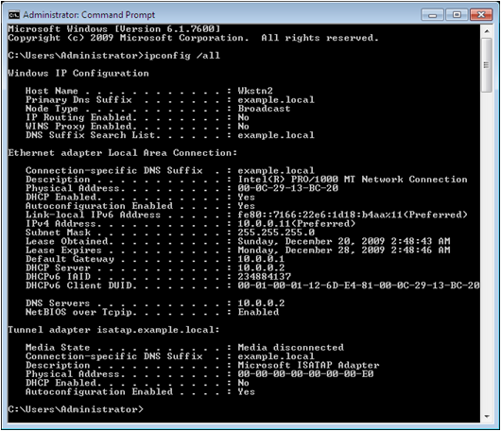
Ipconfig.exe
Ipconfig /all
Ipconfig /release
Ipconfig /renew
Notes:
Outline the purpose of the Ipconfig command and what the different switches do. If you cannot demonstrate, use the screen shot on the slide to help you explain the output of the command.

Slide 38
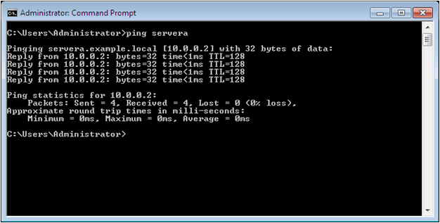
Ping.exe
> Ping target
> Ping ip_address
> Ping computer_name
Notes:
Using the description from the textbook, explain the purpose of ping. If you cannot demonstrate, use the screen shot to help you explain what happens when you use the command.

Slide 39
Tracert.exe
Displays the path (list of routers) that TCP/IP packets take to their final destination.
Internet is constantly changing, therefore the route displayed may not be accurate.
Notes:
Explain the tracert command. Refer to output in the textbook if you cannot demonstrate.

Slide 40
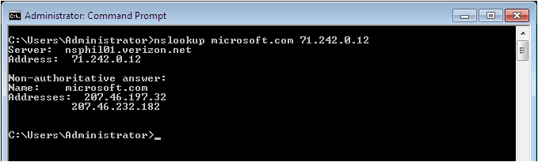
Nslookup.exe
Enables you to generate DNS request messages and transmit them to specific DNS servers:
> Nslookup DNSname DNSserver
Notes:
Explain the purpose of the nslookup command and give examples of what it might be used for. Use the screen shot on the slide if you cannot demonstrate.

Slide 41
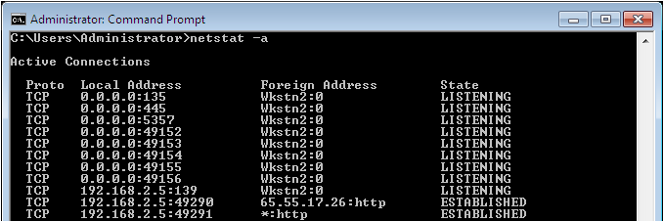
Netstat.exe
Displays status information about the current network connections and about traffic generated by TCP/IP:
NETSTAT [interval][-a][-b][-e][–f]
[–n][–o][-p protocol][-r][-s][-t]
Notes:
Explain the purpose of netstat. Explain what some of the switches mean. Use the screen shot on the slide if you cannot demonstrate.

Slide 42
Skills Summary
The networking stack used on Windows 7 computers corresponds roughly to the seven-layer OSI reference model.
Windows 7 includes support for both the IPv4 and IPv6 protocols.
Network Discovery is a Windows 7 feature that simplifies the task of firewall configuration.

Slide 43
Skills Summary (cont.)
The Network Map utility uses the Link Layer Discovery Protocol (LLTD) to detect network devices and connections.
Most networks use DHCP to configure their TCP/IP clients, but it is still possible to configure them manually.
Windows 7 includes a variety of command line TCP/IP tools, including Ipconfig.exe, Ping.exe, Tracert.exe, Nslookup.exe, and Netstat.exe.

